Slide 1
Prototype’s functionalities
By Ashley kariri

Slide 2
This presentation is to show the functionalities of he prototype in a nun technical way
It is meant to be easy to understand and should be straight forward
By the end of this presentation there if there are any questions please feel free to ask

Slide 3

The home page

Slide 4
This page has is the first page users see when they reach the GLH web site
It has all the links for the other pages that users need to use
It is very clear and simple to understand
It has a background image and the main colour way/skim is green

Slide 5
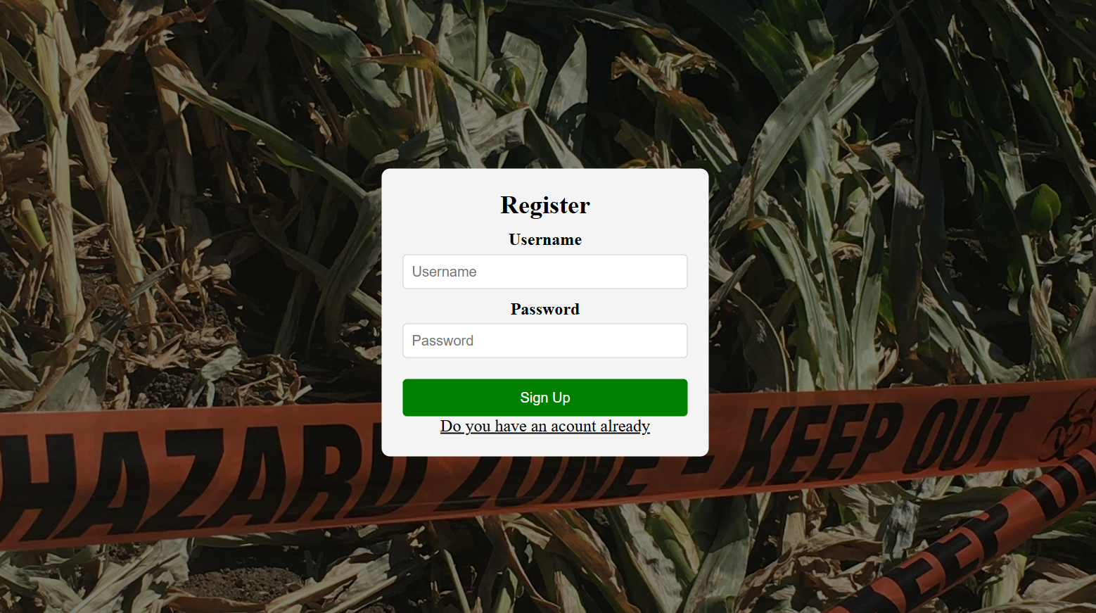
On the home page once a users clicks the register button they will be taken to a registration page where they will be asked to input the username they want and a password
This information will be stored safely, and they should not worry about anything
Once they login they will be taken to the home page again

Slide 6


Once logged in the bar on top of the page will now have the username , their cart and purchase history and the register button would have been removed instead

Slide 7
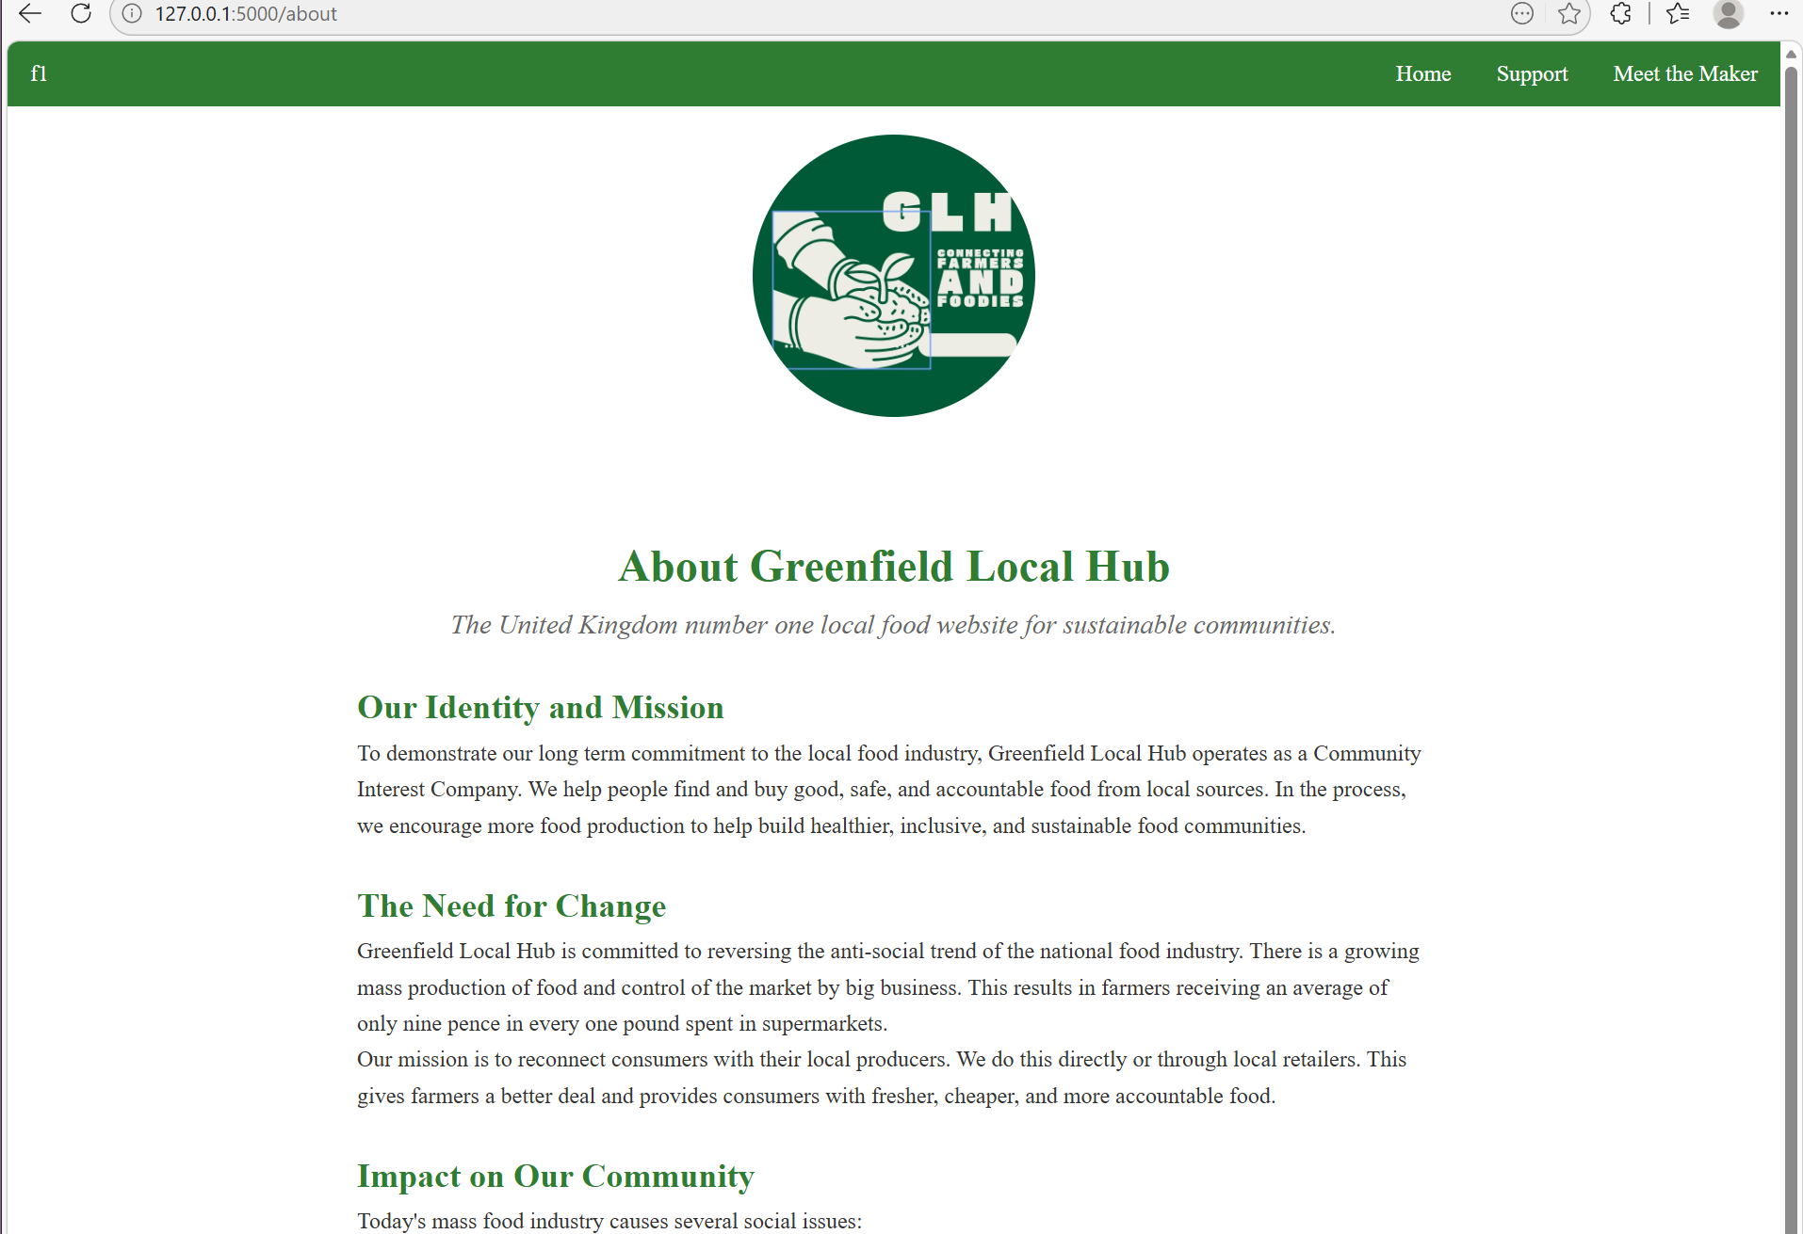
If the user goes to the about page they will see a page with information about GLH

Slide 8
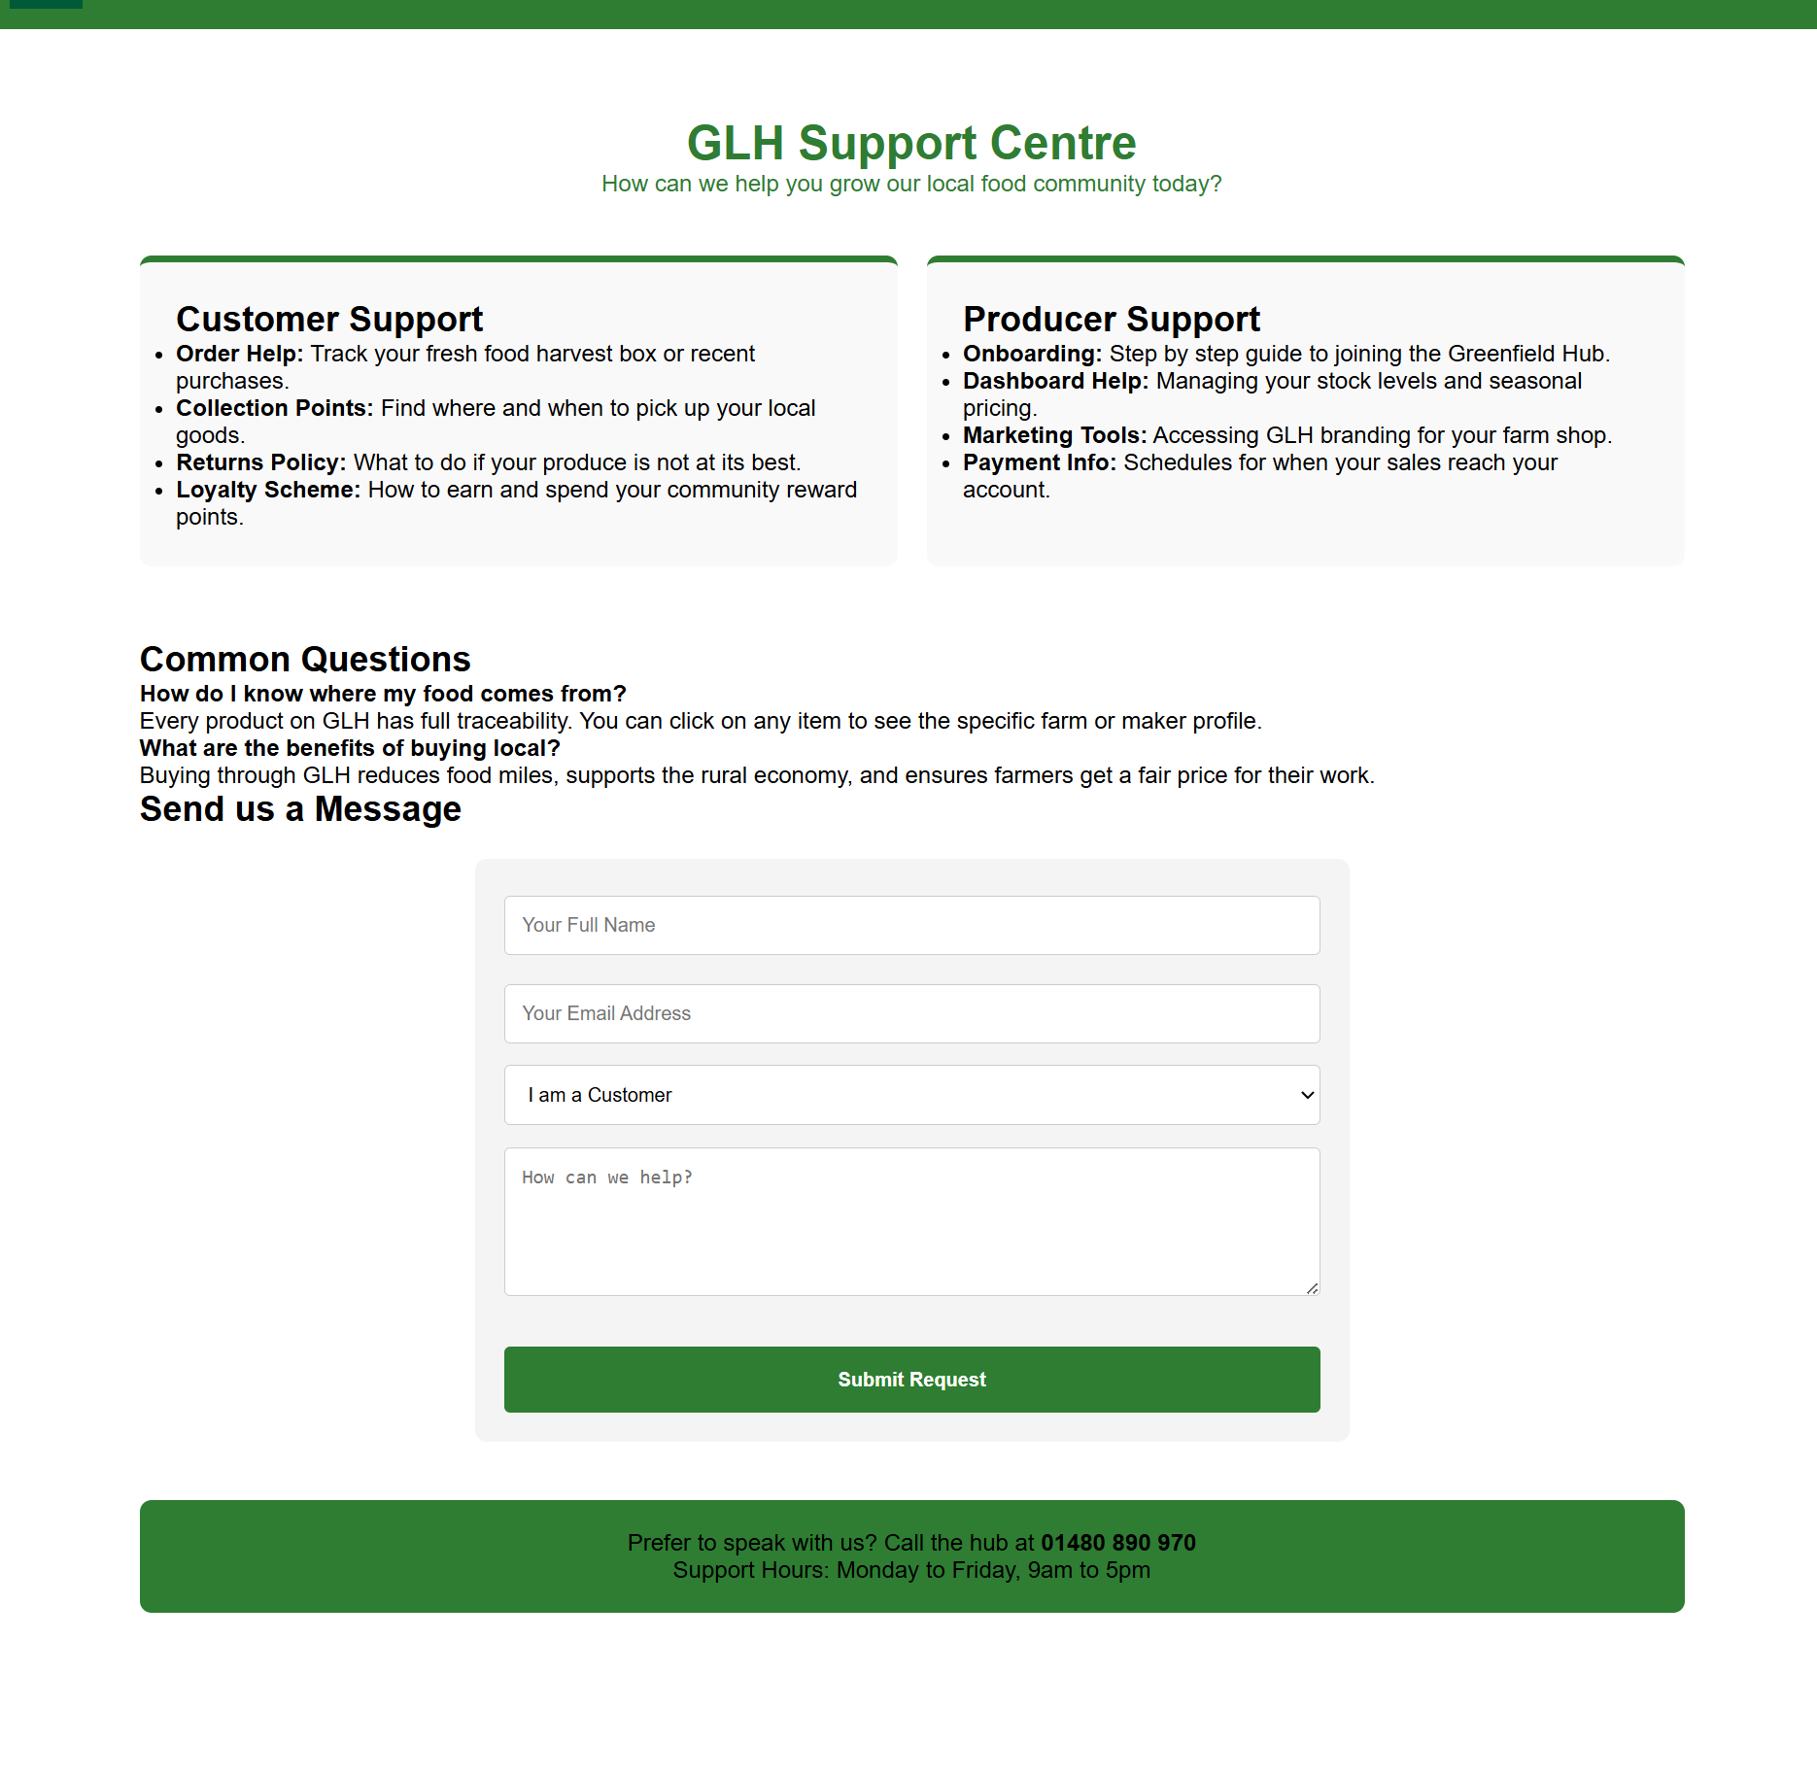
If the user navigate to the support page they will go on to a page where if they find any problem within their account they leave a form that goes straight to the GLH admins for them to read and see what the problem might be

Slide 9
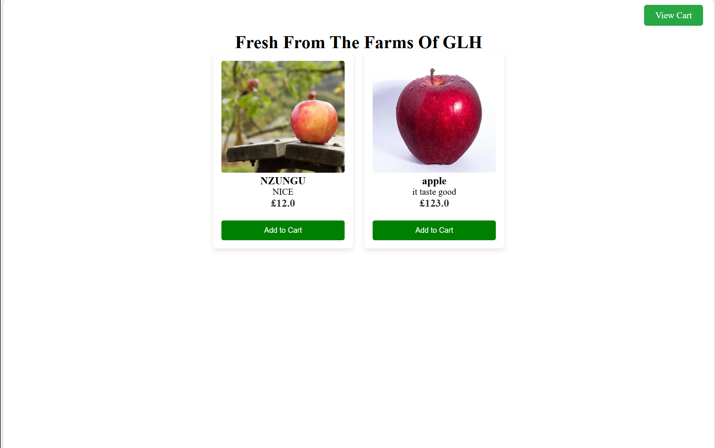
Browse the market page shows the items that are in stock the farmers would have added to the page to the pages and users can add it to their cart and purchase it

Slide 10
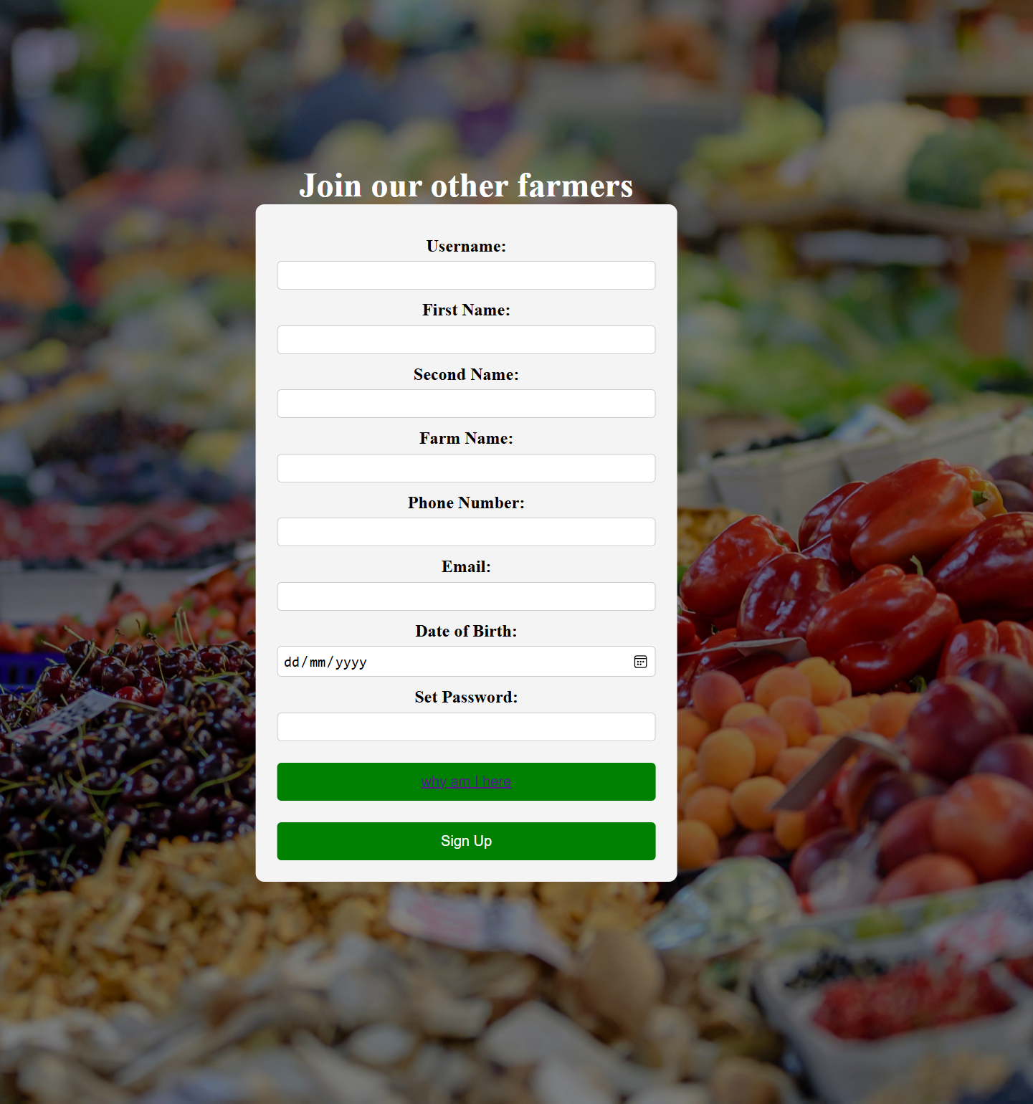
Farmers
The farmers onboarding and sell your harvest work in the same way as they both take you to the farmers login page

Slide 11
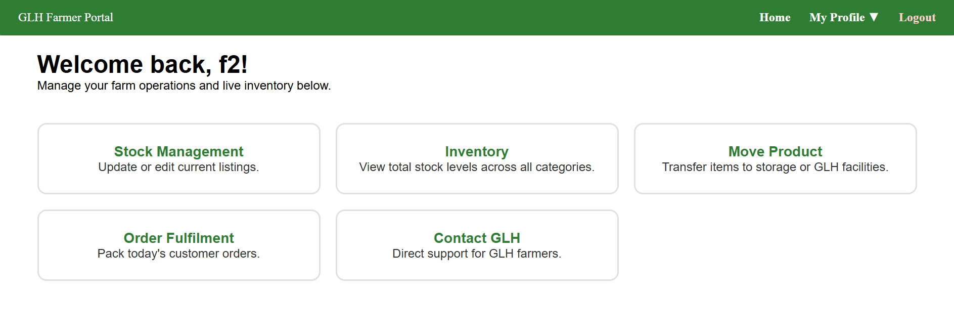
Once all the information has been filled in and all the required information is in the user is then taken to the farmer portal page

Slide 12
On this page the farmers can –
Update their live store front
Contact GLH
--these TWO are still under development
Order fulfilment
Move products to the GLH facilities

Slide 13
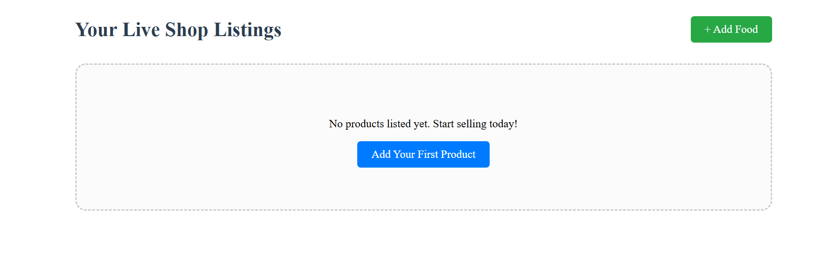
STOCK MANAGEMENT

Slide 14
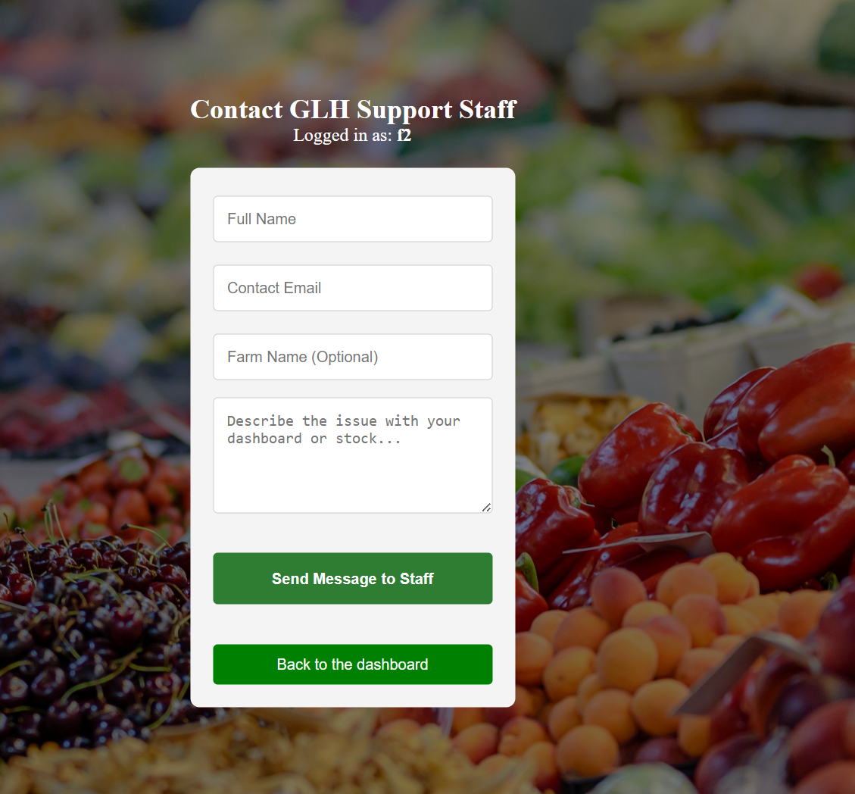
CONATCT GLH

Slide 15
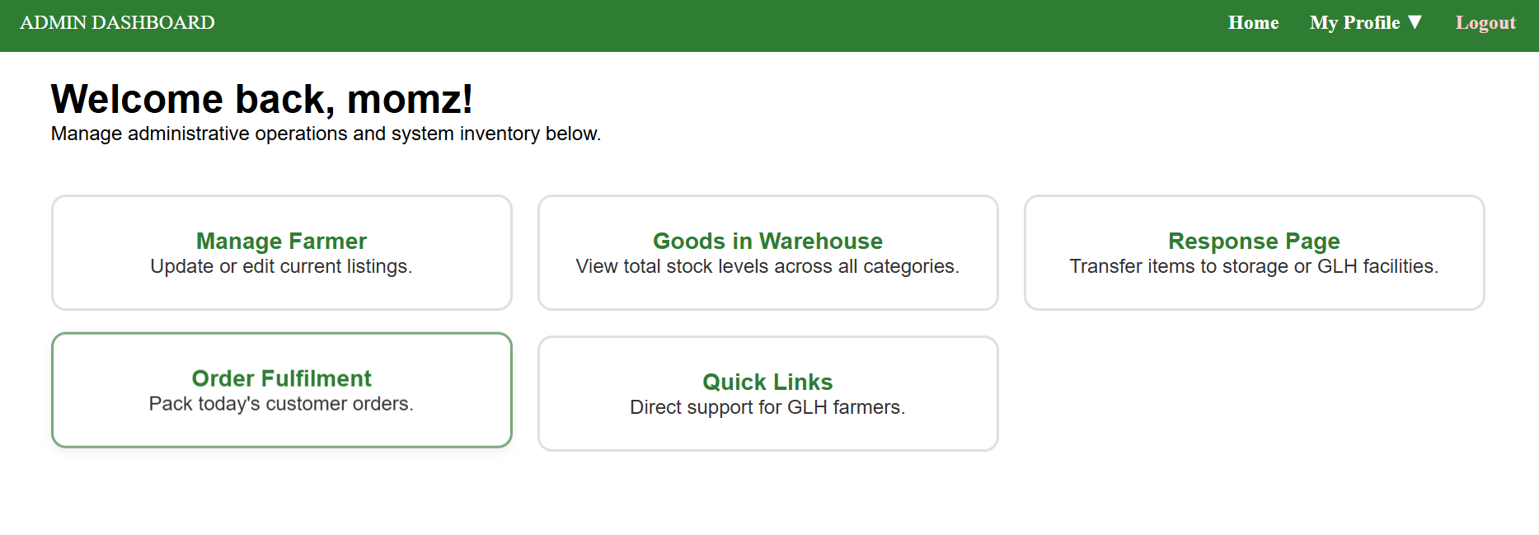
ADMIN PORTAL
This page can be accessed via the regular log in if you have an admin account
But if not they need a secret key to access the page

Slide 16
This page is till under development as much of the focus was put in the clients needs this is just something extra that can be removed if needed

